Slide 1

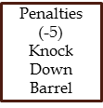

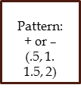
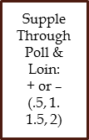
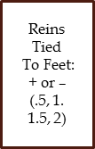
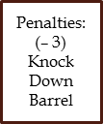
Judged Barrel Racing
TVCC Stock Horse Team
Task Completion
Temperament
Foundation
Track Cow
Time:
+ or –
(.5, 1.
1.5, 2)

